Slide 1
Facts about Business in Stockholm
2015

Slide 2
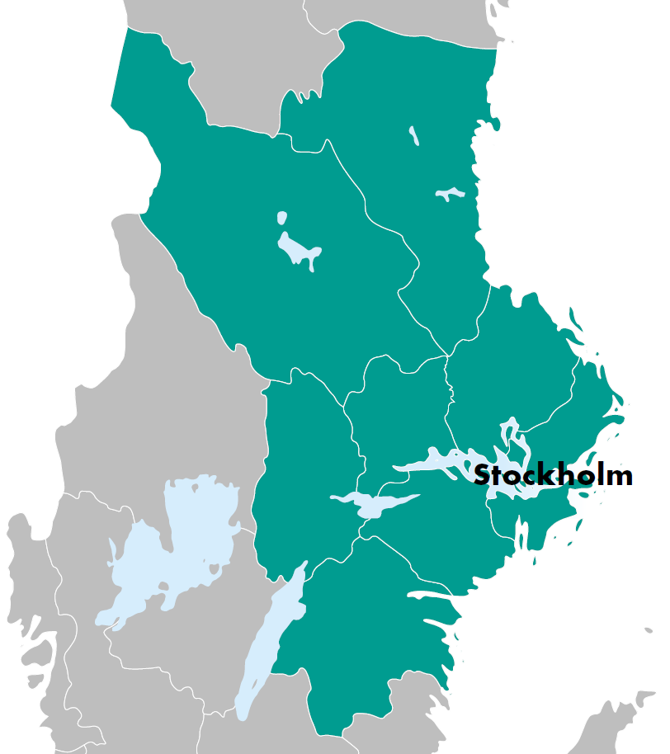
Content
Economy
Business Sector
Workforce and Population
Infrastructure
In this publication the Stockholm Region is defined as the counties; Stockholm County, Uppsala County, Gävleborg County, Västmanland County, Örebro County, Dalarna County, Östergötland County and Södermanland County

Slide 3
Economy
Stockholm is an economic center with strong economic growth and one of Europe’s highest gross regional product per capita.

Slide 4
Regional GDP per capita
Stockholm County has one of Europe’s highest regional GDP per capita. Of the 272 regions in Europe, Stockholm holds 9th place.
Stockholm’s regional GDP per capita is 72 percent higher than the average region in the EU.
Regional GDP per capita (adjusted according to purchasing power), relative to EU28, 2014
Ranking | Region | EU28=100
1 | London | 371
2 | Luxembourg | 266
3 | Brussels | 207
4 | Hamburg | 206
5 | Bratislava | 186
6 | Munich | 179
7 | Paris | 178
8 | Prague | 173
9 | Stockholm | 172
10 | Aberdeen | 164
17 | (Copenhagen) | 157
22 | (Helsinki) | 144
Source: Eurostat

Slide 5
Regional GDP
The Stockholm Region accounts for 51 percent of Sweden’s GDP. In 2014 Stockholm’s
regional GDP reached a new record level of 2,000 billion Swedish kronor (SEK).
Stockholm County accounts for 32 percent of Sweden’s GDP.
Regional GDP, in billion SEK, 2005-2014
Source: Statistics Sweden

Slide 6
Regional GDP per industry
Companies within the industries professional, scientific and technical service, trade and manufacturing contribute most
to Stockholm County’s regional GDP.
Regional GDP, in billion SEK, per industry in Stockholm County, 2014
Industry | MSEK | Share, %
Professional, scientific and technical companies | 153 477 | 12
Trade | 126 941 | 10
Manufacturing industry, mines and quarries | 123 425 | 10
Financial institutions and insurance companies | 107 073 | 9
Information and communication companies | 105 465 | 8
Real estate companies | 100 903 | 8
Human health and social work establishments | 94 719 | 8
Construction industry | 57 451 | 5
Public sector and defence | 51 233 | 4
Educational establishments | 47 914 | 4
Transport and storage companies | 43 717 | 4
Establishments for arts, entertainment and recreation | 36 285 | 3
Electricity, gas, steam and hot water plants | 21 899 | 2
Hotels and restaurants | 20 767 | 2
Other industries | 151 884 | 12
Source: Statistics Sweden

Slide 7
Business Sector
Stockholm is a center for new business creation with more than 23,000 newly registred businesess per year. Stockholm is home to 25 percent of Sweden´s companies.

Slide 8
Entrepreneurship
Stockholm is the center of new business creation in
Sweden. In 2015 approximately 23,300 new companies
were registred in Stockholm County.
The number of company bankruptcies decreased in 2015 to
2,000, a decrease with 300 bancruptcies compared to 2014
and the lowest figure in the past 10 years.
The number of newly registred businesses and company
bankruptcies in Stockholm County, 2005-2015
Source: The Swedish Companies Registration Office and Statistics Sweden

Slide 9
Company Formation
The number of new companies per capita is considerably
higher in Stockholm than in the rest of Sweden.
The City of Stockholm is in the forefront with
above 15 per capita.
Number of new companies per 1000 capita 2015
Source: The Swedish Companies Registration Office and Statistics Sweden

Slide 10
Businesses and industries
Stockholm County is home to one fourth of Sweden’s businesses. In total there are 300.000 companies in the Stockholm County with more than 1,6 million employees.
In Stockholm County most people are employed in medium or large size companies with more than 200 employees. More than 1 000 000 people work in these type of companies.
.
The number of companies and employees arranged according to size of company (number of employees) in Stockholm, 2015
Source: Statistics Sweden

Slide 11
Industry structure
The Service Sector is dominant in Stockholm County. Professional, scientific and technical companies account for about 300,000 of the businesses in the County. Thereafter trade with about 200,000 employees is the industry with the highest number of employees.
The number of companies and employees arranged according to industry in Stockholm, 2015
Source: Statistics Sweden

Slide 12
Business areas
The number of workplaces and employees in business areas in the City of Stockholm, 2015
In Stockholm there are 26 business areas well distributed across the city. They are generally situated close to the main arterial roads that provide good accessibility for the transportation of both passengers and goods.
The largest business area is City with more than 122,000 employees. This represents close to half of the total number of employees in the City of Stockholm.
Kista is the second largest business area with about 30,000 employees distributed among approximately 800 companies.
Source: Statistics Sweden

Slide 13
Foreign ownership
The is a large influence of international companies in Stockholm. The number of employees in foreign-owned companies has increased gradually and in 2015 they amounted to 230,000 people in Stockholm County. This being an increase by 40 % compared to 2005 when about 160,000 people were employed in foreign owned businesses
The number of employees in foreign-owned companies in Stockholm County, 2005–2015
Source: Statistics Sweden

Slide 14
Foreign ownership by industry
There are over 16,000 foreign-owned companies in Stockholm County, representing 60 percent of all foreign-owned companies in Sweden. Trade is the industry in Stockholm County with the largest number of foreign-owned companies with a total of around 55,000 employees. Thereafter comes professional, scientific and technical companies with 45,000 employees.
The number of companies and employees with foreign owners by industry, 2015
Source: Statistics Sweden

Slide 15
Workforce and Population
Stockholm is one of Europe’s fastest growing cities with a large supply of both manpower and companies.

Slide 16
Employment rate
The number of people employed has increased both in the Stockholm region and in Sweden during the period from 2008 to 2015.
The increase of employment rate in Stockholm County between 2008 and 2015 corresponds to 62 percent of the employment rate growth in Sweden during the same period.
Between 2008-2015 the number of employed people in Stockholms County has increased with more than 126,000 people, which is an increase of 12 percent.
The number of employed people, 2008-2015 (Index = 2008 Q1)
Source: Statistics Sweden

Slide 17
Labour market
Unemployment relative to the workforce has increased in Sweden since 2008. The unemployment rate peaked in 2010 and has since then decreased.
The unemployment rate is lower both in Stockholm County and the City of Stockholm than in the rest of Sweden.
The unemployment rate in the City of Stockholm and Stockholm County was abous 5,5 percent in 2015.
Percentage (%) of unemployed relative to the workforce, 2008-2015
Source: Statistics Sweden

Slide 18
Number of recently listed positions
The number of recently listed positions with the Public Employment Service has been high for some years now. In Stockholm County there were 320,000 new positions listed in 2015 which is the highest figure during the past 10 years.
12,100 employees were given notice in 2015, which is the lowest figure since 2010.
Number of new positions listed with the Public Employment Service and the number of people given notice in Stockholm County, 2005–2015
Source: The Labor Exchange

Slide 19
Education
Access to a well-educated workforce is a necessary prerequisite for the international competitiveness of industrial and commercial life.
In the Stockholm Region 49 percent of the population between the age of 20-64 years have a post-secondary education. It is a higher share than in the rest of Sweden.
Percentage of population (20–64 years) with post-secondary education, 2015
Source: Statistics Sweden

Slide 20
Population
The last ten years the number of residents increased by
470,000 in the Stockholm Region, of which Stockholm County accounted for 70 % of the increase.
Between 2014 and 2015 the population grew with about 33,000 people, of which 11,500 resided in the City of Stockholm
Population development from 2005–2015 (index 100 = 2005)
Source: Statistics Sweden

Slide 21
Population by municipality
The Stockholm Region is by far the largest region with 4.4 million inhabitants or 45 % of the Swedish population.
More than 2.2 million people live in Stockholm County. Most people live in the City of Stockholm followed by the municipalities of Huddinge, Nacka and Södertälje.
The number of inhabitants in Stockholm by municipality, 2015
Source: Statistics Sweden

Slide 22
Infrastructure
Planned infrastructure investments in Stockholm are currently worth about 100 billion euro until 2021.

Slide 23
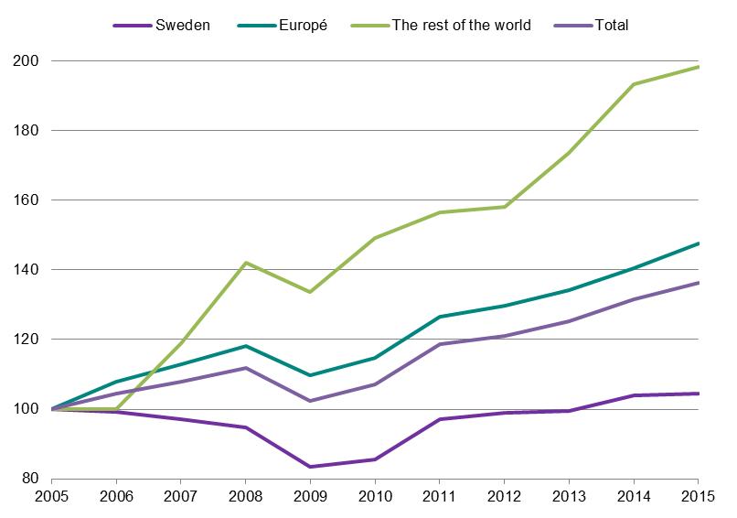
Communications – airline passengers
The Stockholm Region has eight airports which during 2015 reached a new
record level with a total of 28 million passengers. During the past 10 years the
number of airline passengers in the Stockholm Region has increased
by 36 percent.
Arriving and departing airline passengers, 2005-2015 (in thousands)
Source: Swedish Transport Agency

Slide 24
Residences
During 2015, the number of apartment projects that
were started in the Stockholm Region reached 23,000.
About 50 percent of the new apartment projects
were started in Stockholm County.
Number of apartment projects in Stockholm, 2005-2015
Source: Statistics Sweden

Slide 25
Commercial properties- vacancy levels
Stockholm offers good availability of different types of facilities, both in the center of Stockholm as in attractive local subarbean locations.
Office spaces in the Central Business District are the most attractive, and vacancy levels have declined in recent years and is now at three percent.
Vacancy levels for Stockholm total have decreased during the past year and are now at 7 percent.
Vacancy levels (%) for office spaces in Stockholm, 2010-2016
Source: JLL

Slide 26
Commercial properties- market rent levels
Market rent levels for vacant office premises have increased in Stockholm during the past years.
The market rent levels are now 50 percent lower in local subarbean locations than in the center of Stockholm.
Market rent levels in Stockholm, 2007-2016
Source: JLL

Slide 27
Residences
The Stockholm Region contains about 45 percent of the housing stock in Sweden. The majority, approximately one million residences, live in Stockholm County.
Since 2000, the housing stock increased by 18 percent in Stockholm County. The City of Stockholm, Nacka and Solna have accounted for the largest increases in volume.
Housing stock in Stockholm 2015
Source: Statistics Sweden

