Slide 1
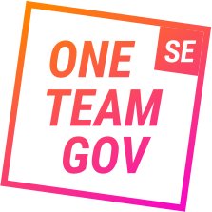
ONE TEAM GOV SVERIGE
Adrian Solitander,
Med-initiativtagare, One Team Gov Sverige

Slide 2
ONE TEAM GOV SVERIGE
En gräsrotsrörelse för att förnya offentlig verksamhet genom praktiska åtgärder.

Slide 3
Kort om mig

Slide 4
Brist på samtal över gränser
Brist på samsyn
Brist på förståelse för varandra
Notes:
The verticality of the Swedish public sector hinders coordinated policy implementation.
Some actors expressed the need to create dynamic spaces (either physical or digital) for risk-controlled experimentation, digital- and data-driven innovation, multistakeholder engagement, and problem-solving collaboration. Others expressed the urgent need to “start building a beta version” of a smarter and agile government, and provide a platform where officials can build, experiment and test ideas in risk-controlled environments. The role of the new agency should be capitalised on in this respect.
Many cultural factors related to equality (no hierarchic management models), teamwork mentality, public officials’ high education levels, networking co-operation and digital skills are recognised as important preconditions to scale-up existing cases of experimentations e.g. curiosity-driven public officials who are willing to experiment with new ways of doing things. These are indeed cultural traits that contribute to the readiness (capability) of the Swedish public sector to move towards a digital government. The agency should assist to put this capability and willingness into action and help scale-up existing initiatives. This implies overcoming some cultural challenges related to a state of complacency, an increased focus on facts/efficiency than on experimentation and innovation, and emphasis on big IT projects, rather than on a more incremental mind-set that can be used to experiment with small initiatives than can later be scaled-up.
Organisational culture within the Swedish public sector emerged both as an enabler and barrier for digital and datadriven innovation. Some aspects of the Swedish public sector seem to create a skill- and cultural-base that can be used to leverage digital innovation, but this culture may also obstruct creativity and reward compliance with the status-quo.

Slide 5
29 June 2017
200 people
7 weeks
@kitterati

Slide 6
‘How do we make this event a movement?’

Slide 7
Arbeta öppet och positivt
Göra saker i praktiken
Experimentera och iterera
Bejaka mångfald och vara inkluderande
I hjärtat bry oss om människor
Arbeta gränsöverskridande
Välkomna teknikens möjligheter
Notes:
Communication strategies are in many instances limited to one-way information provision. Communication is not identified as a means towards policy buy-in and engagement and public officials are mainly informed about policy goals and expectations in line with a “do-deliver-and-comply public administrator mind-set”. This hinders the possibility of engaging actors and identifying key partners and allies across the broad public sector from early stages of policy definition.
A more inclusive policy-making process would also help crowdsourcing and embedding public officials’ inputs in policy goals, when defining priorities and co-creating the content of the agenda in itself. As a whole, this process would contribute to increasing policy ownership among public officials.
Final users and citizens have had no involvement in these coordination fora thereby limiting the adoption of userdriven approaches for policy making. Most commonly, practices around users’ needs are still grounded on an e-government user-centred approach where those needs are assumed but not explored, and are not placed at the core of problem solving and policy design processes.

Slide 8
Gjorde en shout out och dessa svarade ☺

Slide 9
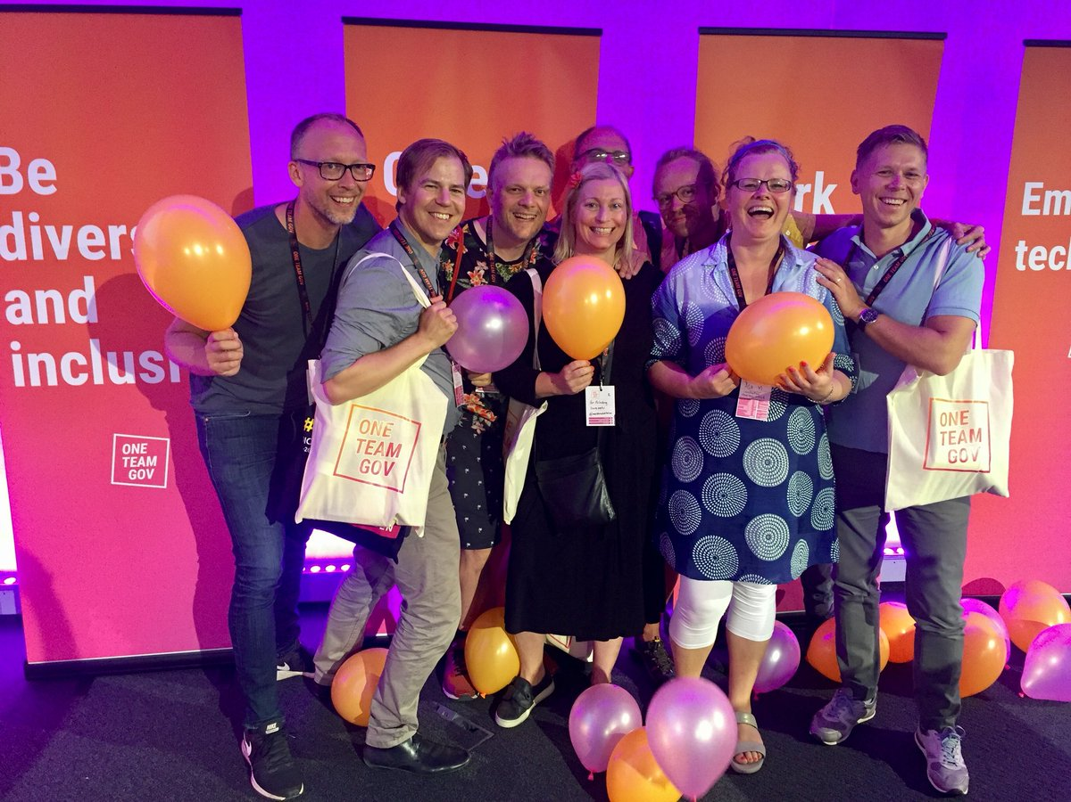

Slide 10
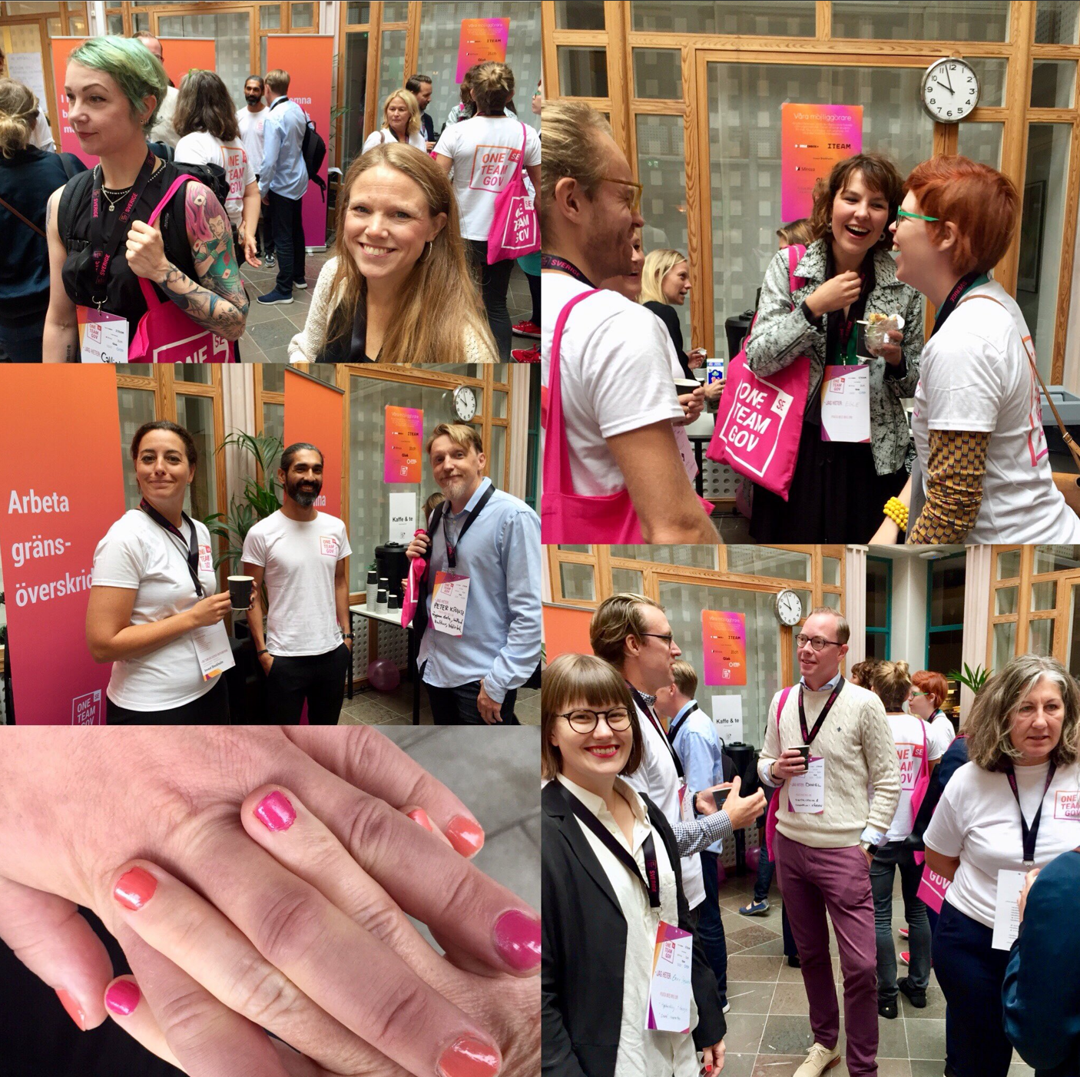
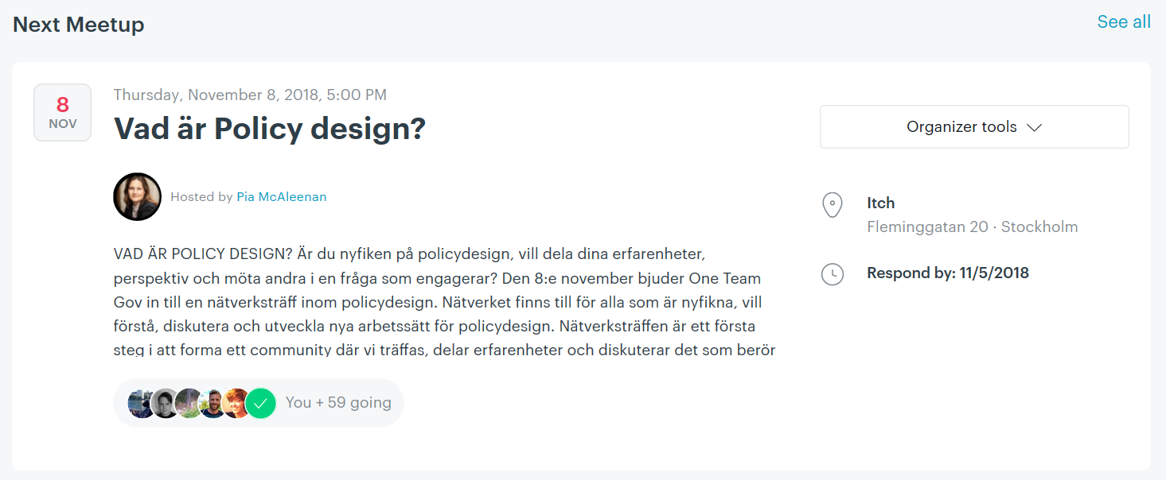
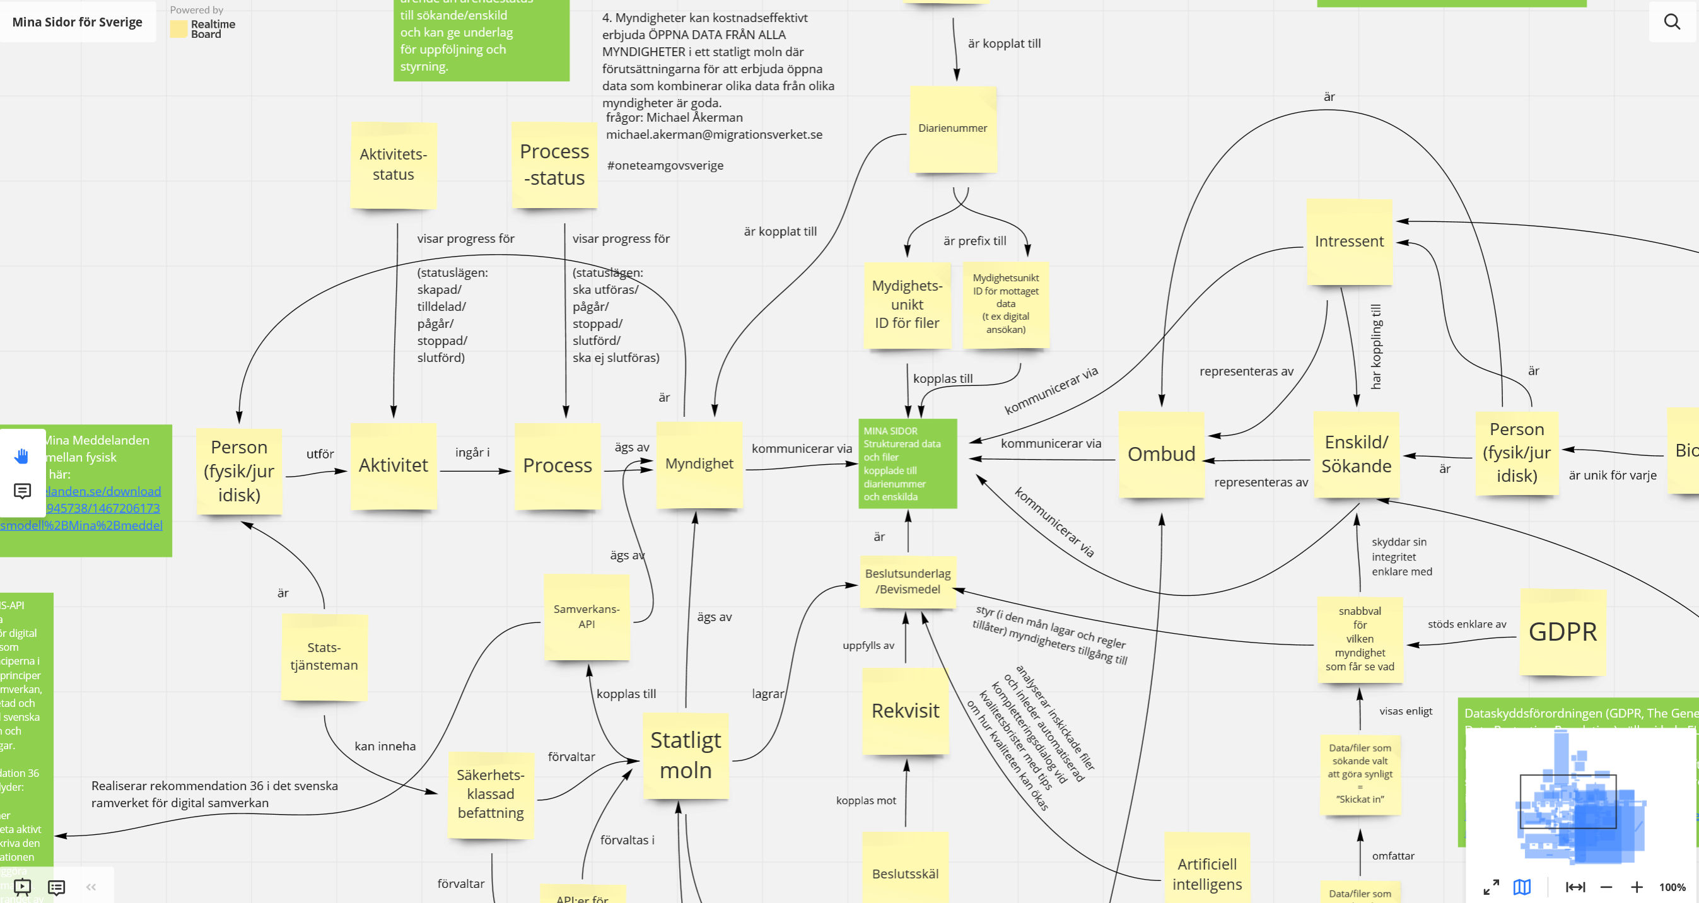

Slide 11
Och..?

Slide 12
Nätverkssamhällets framväxt påverkar tjänstemannarollen
Vi bidrar till kulturförändring

Slide 13
Även ledarskapet påverkas

Slide 14
Du kan göra vad du vill med One Team Gov Sverige
One Team Gov är en öppen rörelse och det är fritt fram att upprepa och anpassa.
Välkommen med!

Slide 15
Vi skapar ett utrymme att säga det oväntade och obekväma
Notes:
Unwritten social codes e.g. avoid causing discomfort to others or unpleasant social and work environments (Dålig stämning as it is known in Swedish), are evident. However, this results from public officials’ self-reticence to express their opinion for the sake of cordiality.
Creating safe spaces for experimentation and ideas exchange is urgent in order to move from a bureaucratic mind-set to an environment driven by risk-controlled entrepreneurship.

Slide 16
Vi skapar stolthet för att jobba i det offentliga

Slide 17
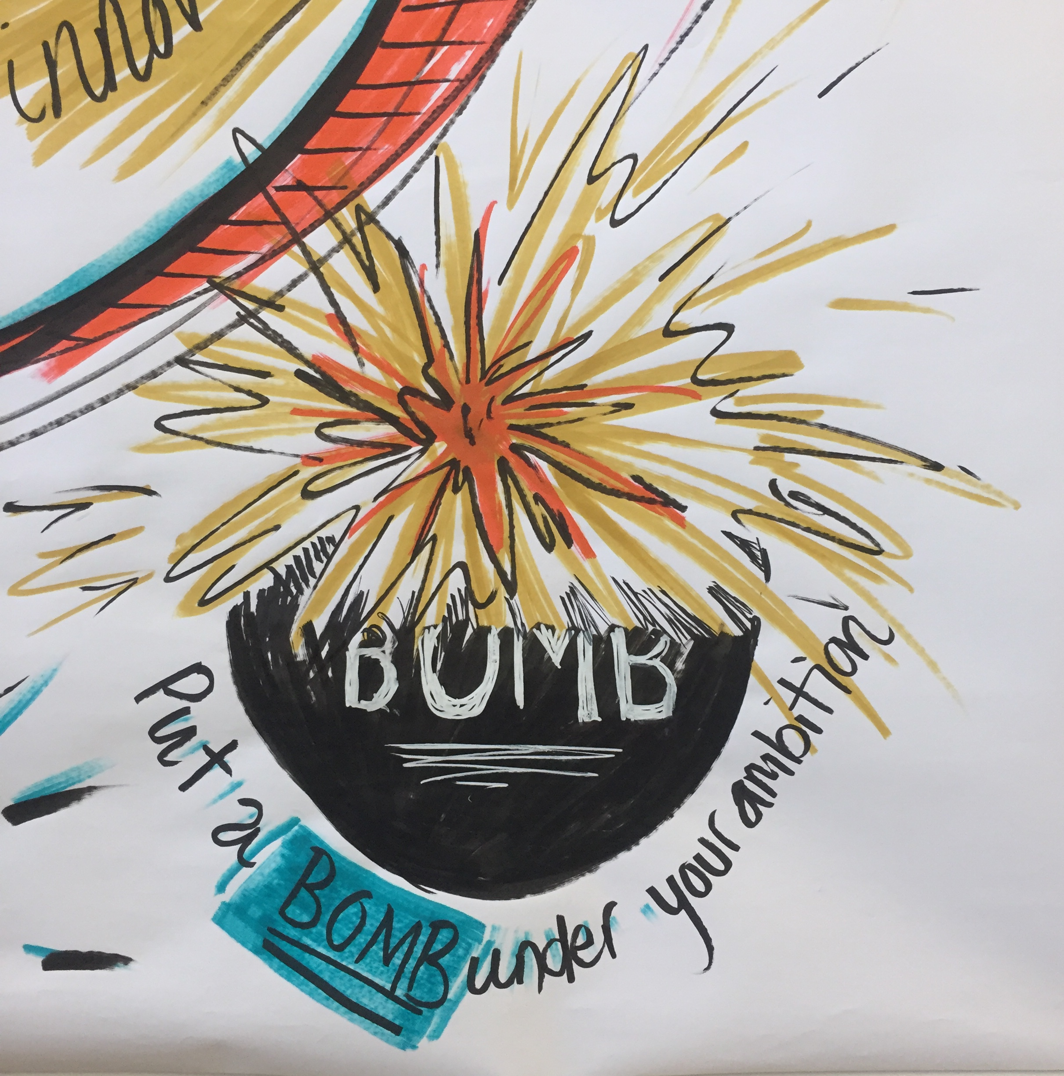
Gör saker i praktiken

Slide 18
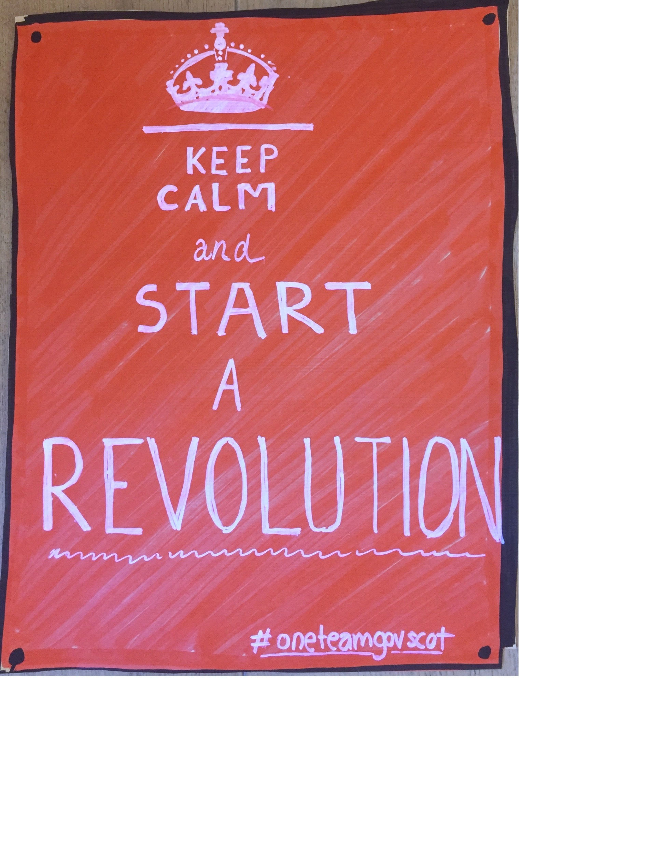
Om du inte orkar vänta på revolutionen, starta den själv

